Slide 1
Reset
What Does it Mean to Follow Jesus?
Last Week: Resetting Your Mind

Slide 2
30-Day Bible Challenge
1. Sit in silence to refocus — about 1 minute
2. Read the Bible passage for the day — 5 minutes
3. What would I have seen, heard, felt,
experienced if I were present? — 2 minutes
4. What teaching moments did God want
to share with me in this story? — 1 minute
5. Pray for God to reveal what He wants
you to do differently/better — 1 minute

Slide 3
Today’s Topic
Resetting Your Story
Mark 5:1–20

Slide 4
Who Are You?

Slide 5
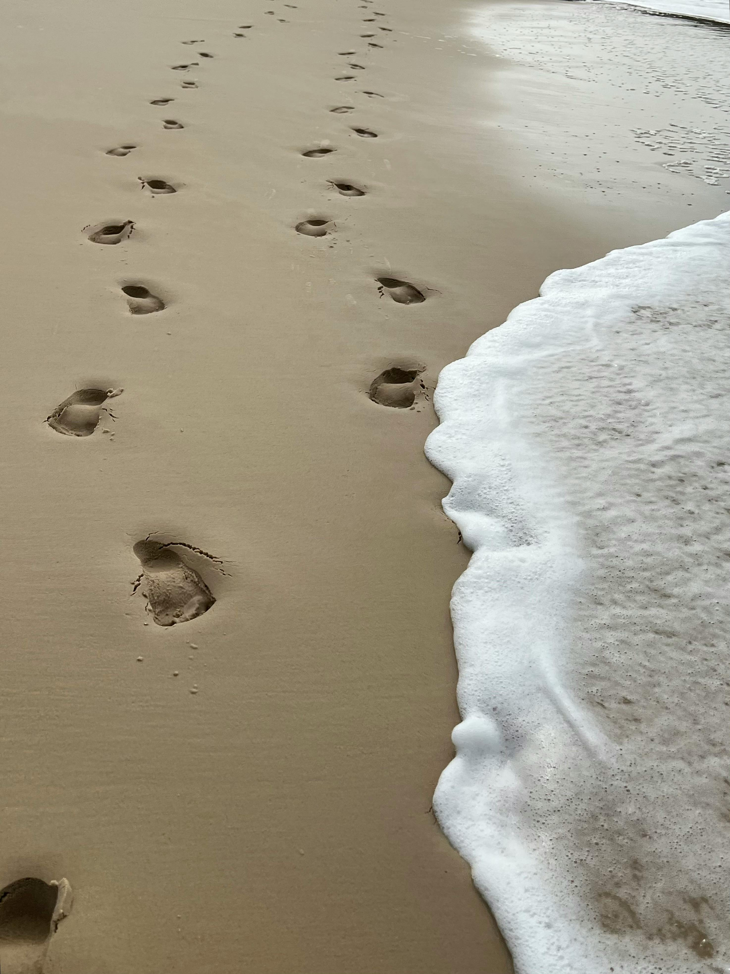
What Is a Disciple?
— More than a student
— More than an apprentice
— Jesus’ disciples lived, traveled,
ate, and hung out with Jesus 24/7.

Slide 6
Mark 4:35–41
35 On that day, when evening had come, he [Jesus] said to them, “Let us go across to the other side.” 36 And leaving the crowd, they [the disciples] took him with them in the boat, just as he was. And other boats were with him. 37 And a great windstorm arose, and the waves were breaking into the boat, so that the boat was already filling. 38 But he was in the stern, asleep on the cushion. And they woke him and said to him, “Teacher, do you not care that we are perishing?” 39 And he awoke and rebuked the wind and said to the sea, “Peace! Be still!” And the wind ceased, and there was a great calm. 40 He said to them, “Why are you so afraid? Have you still no faith?” 41 And they were filled with great fear and said to one another, “Who then is this, that even the wind and the sea obey him?”

Slide 7
Mark 5:1–5
1 They came to the other side of the sea, to the country of the Gerasenes. 2 And when Jesus had stepped out of the boat, immediately there met him out of the tombs a man with an unclean spirit. 3 He lived among the tombs. And no one could bind him anymore, not even with a chain, 4 for he had often been bound with shackles and chains, but he wrenched the chains apart, and he broke the shackles in pieces. No one had the strength to subdue him. 5 Night and day among the tombs and on the mountains he was always crying out and cutting himself with stones.

Slide 8
Mark 5:6–7
6 And when he saw Jesus from afar, he ran and fell down before him. 7 And crying out with a loud voice, he said, “What have you to do with me, Jesus, Son of the Most High God? I adjure you by God, do not torment me.”

Slide 9
Encounter with Jesus

Slide 10
Mark 5:8, 9
8 For he [Jesus] was saying to him, “Come out of the man, you unclean spirit!” 9 And Jesus asked him, “What is your name?” He replied, “My name is Legion, for we are many.”

Slide 11
Jesus Wants to
Reset Your Story

Slide 12
Mark 5:10–17
10 And he begged him earnestly not to send them out of the country. 11 Now a great herd of pigs was feeding there on the hillside, 12 and they begged him, saying, “Send us to the pigs; let us enter them.” 13 So he gave them permission. And the unclean spirits came out and entered the pigs; and the herd, numbering about two thousand, rushed down the steep bank into the sea and drowned in the sea.
14 The herdsmen fled and told it in the city and in the country. And people came to see what it was that had happened. 15 And they came to Jesus and saw the demon-possessed man, the one who had had the legion, sitting there, clothed and in his right mind, and they were afraid. 16 And those who had seen it described to them what had happened to the demon-possessed man and to the pigs. 17 And they began to beg Jesus to depart from their region.

Slide 13
Not Everyone
Will Understand

Slide 14
Mark 5:18–20
18 As he was getting into the boat, the man who had been possessed with demons begged him that he might be with him. 19 And he did not permit him but said to him, “Go home to your friends and tell them how much the Lord has done for you, and how he has had mercy on you.” 20 And he went away and began to proclaim in the Decapolis how much Jesus had done for him, and everyone marveled.

Slide 15
Tell Your Friends
What God Has Done
for You

Slide 16
Mark 6:53–56
53 When they had crossed over, they came to land at Gennesaret and moored to the shore. 54 And when they got out of the boat, the people immediately recognized him 55 and ran about the whole region and began to bring the sick people on their beds to wherever they heard he was. 56 And wherever he came, in villages, cities, or countryside, they laid the sick in the marketplaces and implored him that they might touch even the fringe of his garment. And as many as touched it were made well.

